Slide 1

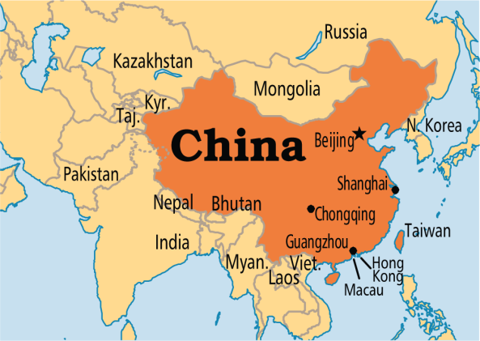

Internationalizing DateTime (I18N with DateTime)
The format of the date and time differ from one region to another that is why we internationalize the date and time.
We can internationalize the date and time by using the getDateTimeInstance() method of the DateFormat class. It receives the locale object as a parameter and returns the instance of the DateFormat class.
Language = English
Feb 19, 2018 6:58:40 PM
Language = Chinese
2018-2-19 18:58:40
Language = French
19 févr. 2018 18:58:40

